Slide 1
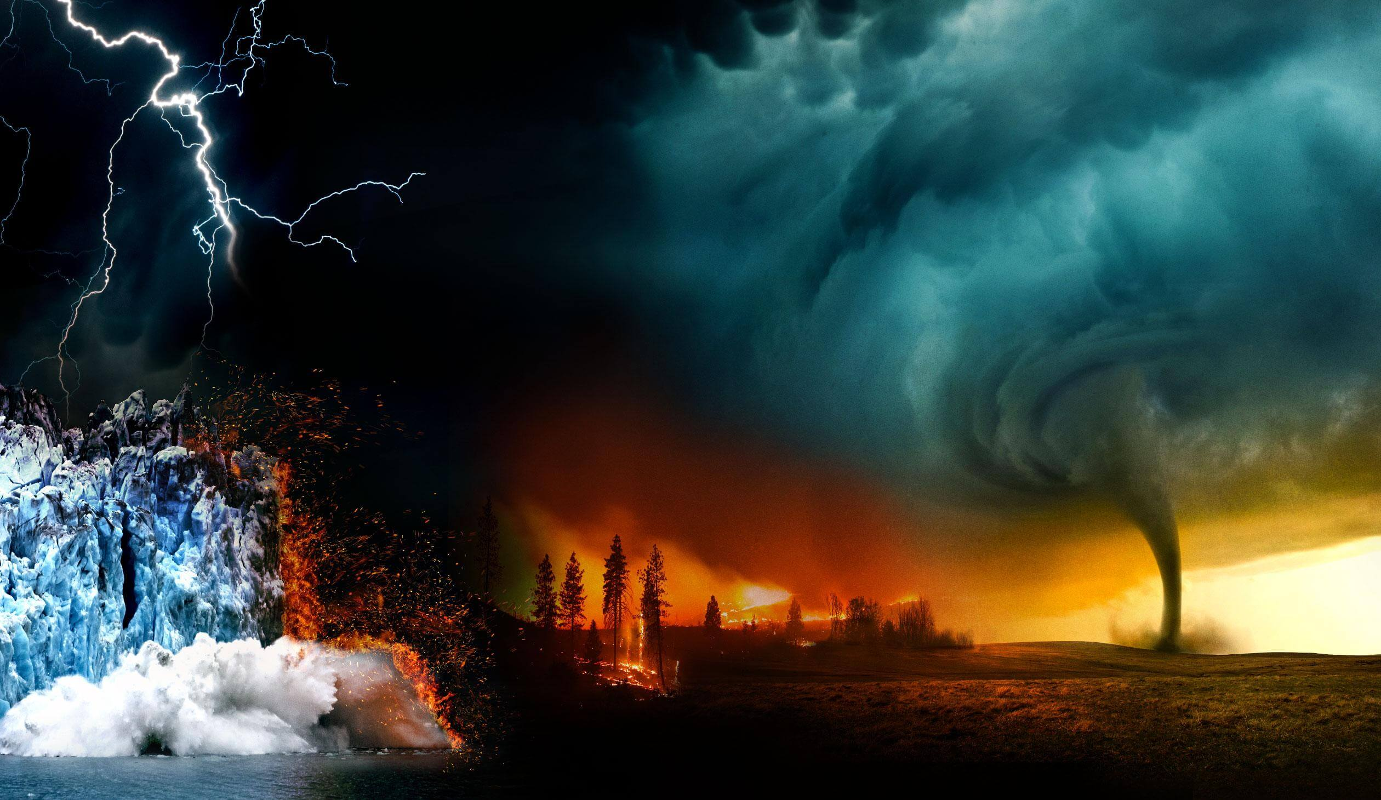
Climate Change

Slide 2
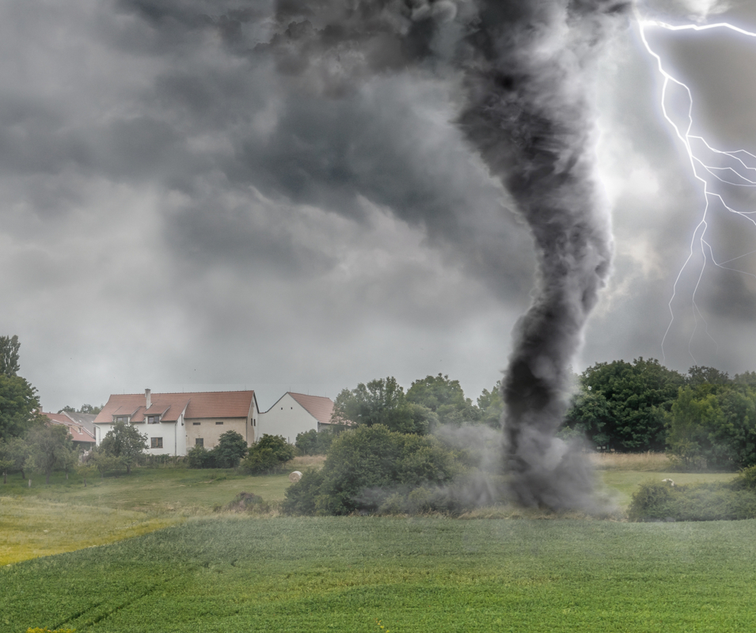
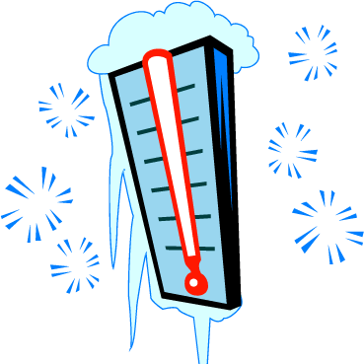
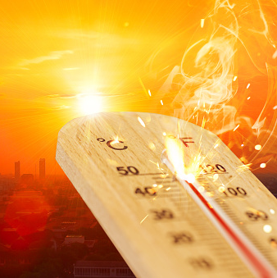
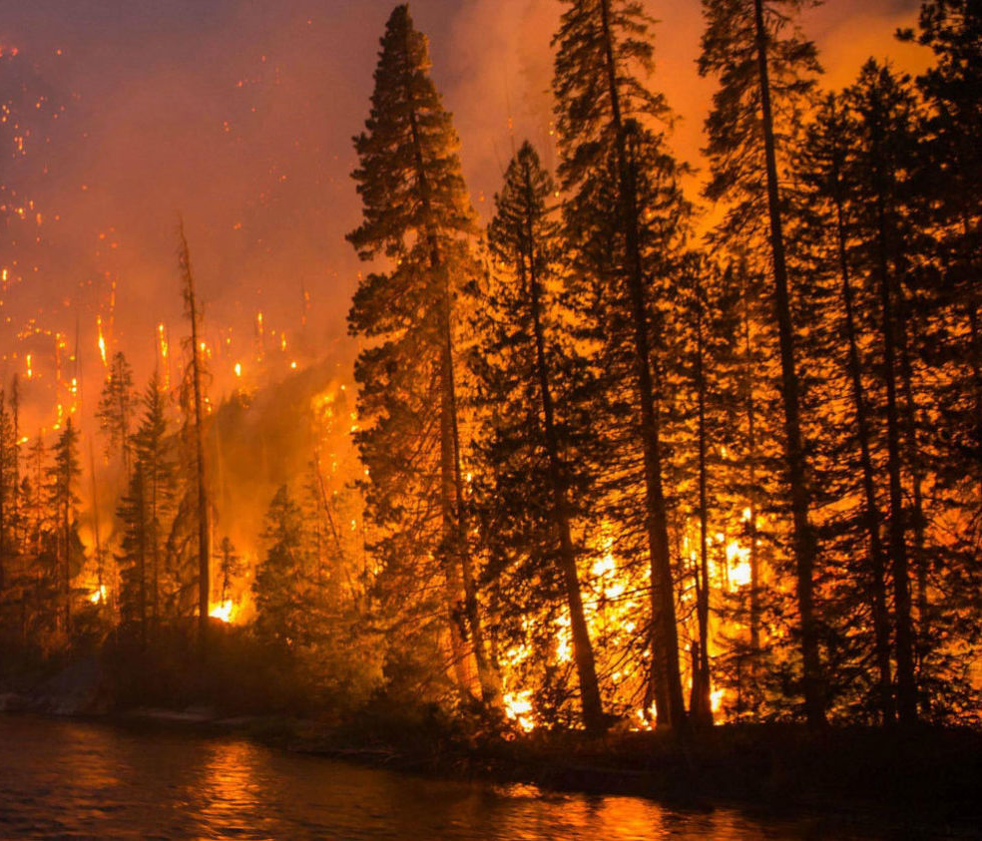
Why are you worried about climate change?
The weather is more extreme
Hotter summers and colder winters
Natural disasters (hurricanes, tornado, etc.)
Forest fires (Australia, California, etc.)
Air pollution
Animals losing their home

Slide 3
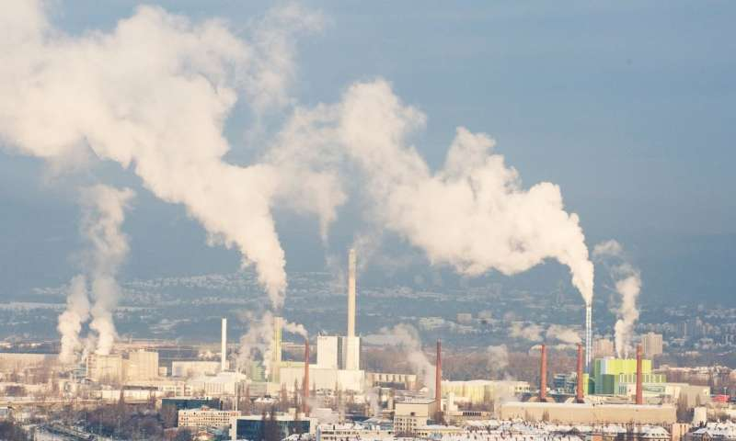
What consequences could climate change have for your life?
The weather is changing
Air pollution

